Slide 1
Chapter 7:
Software Engineering
Computer Science: An Overview
Eleventh Edition
by
J. Glenn Brookshear

Slide 2
Chapter 7: Software Engineering
7.1 The Software Engineering Discipline
7.2 The Software Life Cycle
7.3 Software Engineering Methodologies
7.4 Modularity
7-<number>

Slide 3
The Software Engineering Discipline
The development of a large, complex software system:
  How can you estimate the cost in time, money, and other resources to complete the project?
  How can you divide the project into manageable pieces?
  How can you ensure that the pieces produced are compatible?
  How can those working on the various pieces communicate?
  How can you measure progress?
  How can you cope with the wide range of detail?
7-<number>

Slide 4
The Software Engineering Discipline (Cont.)
Distinct from other engineering fields
  Prefabricated components (off-the-shelf components) vs. domain specific in the context of software eng.
  Metrics for measuring the properties of software (the quality of a mechanical device is often measured in terms of the mean time between failures)
Practitioners (developing techniques for immediate application) versus Theoreticians (searching for underlying principles and theories on which more stable techniques can someday be constructed)
7-<number>

Slide 5
Computer Aided Software Engineering (CASE) tools
Project planning systems
  to assist in cost estimation, project scheduling, and personnel allocation
Project management systems
  to assist in monitoring the progress of the development project
Documentation tools
  to assist in writing and organizing documentation
7-<number>

Slide 6
Computer Aided Software Engineering (CASE) tools
Prototyping and simulation systems
  to assist in the development of prototypes
Interface design systems
  to assist in the development of GUIs
Programming systems
  to assist in writing and debugging programs
  e.g., when given specifications for a part of a systems, produce high-level language programs
7-<number>

Slide 7
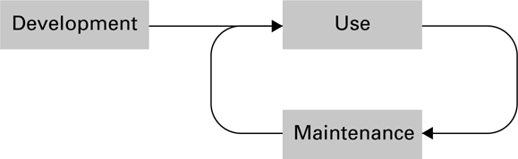
Figure 7.1 The software life cycle
The products other than software tend to deteriorate. (maintenance: repair)
Software, on the other hand, does not deteriorate. (maintenance: errors, application change, etc.)
7-<number>

Slide 8
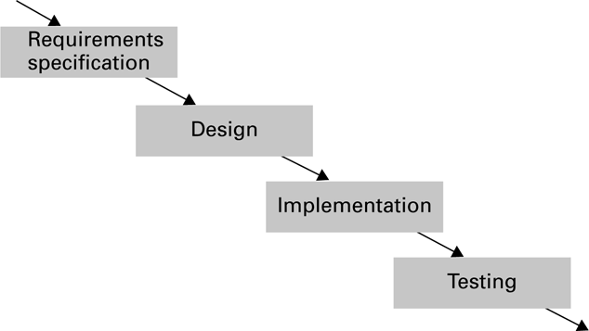
Figure 7.2 The development phase of the software life cycle
7-<number>

Slide 9
Analysis Stage
To specify what services to provide and to identify any conditions on those services
Significant input from the future user
  A feasibility study by the user
  A market study by the software developer
Requirements (the new system must satisfy)
  Application oriented
  E.g., “access to data must be restricted to authorized personnel”
7-<number>

Slide 10
Analysis Stage (Cont.)
Specifications
  Technically oriented
  E.g., “the system will not respond until an approved eight-digit password has been typed at the keyboard
Software requirements document
  Including requirements and specifications
  A written agreement between all parties concerned
7-<number>

Slide 11
Design Stage
Analysis: what the proposed system should do; Design: how the system will accomplish those goals
Diagramming and modeling play important roles in the design of software (much like the blueprints of architecture)
Human interface (psychology and ergonomics)
7-<number>

Slide 12
Implementation Stage
Create system from design
  Write programs
  Create data files
  Develop databases
Role of “software analyst” versus “programmer”
  Software analyst: emphasis on the analysis and design steps
  Programmer: is charged with writing programs
7-<number>

Slide 13
Testing Stage
Validation testing
  Confirm that system meets requirements and specifications of the original analysis
  E.g., the system does produce a properly formatted summary of a bank customer’s account
Defect testing
  Identify and correct bugs
  E.g., reveal that the account balance appearing in that report is incorrect
7-<number>

Slide 14
Software Engineering Methodologies
Waterfall Model (flow in only one direction)
  Analysis, design, implementation, and testing in a strictly sequential order.
Incremental Model
  A simplified version of the final product, and then more features added in an incremental manner
  Prototyping (Evolutionary vs. Throwaway): build and evaluate prototypes (incomplete versions of the proposed system)
7-<number>

Slide 15
Software Engineering Methodologies (Cont.)
Open-source Development (e.g., the Linux operating system)
  A single author writes an initial version and posts the source code and documentation on the Internet
  Modified or enhanced by others
  Report these changed to the original author
  Further modifications
Extreme Programming (by Kent Beck in 1996)
  Developed incrementally by means of repeated daily cycles
  Characterized by flexibility compared with “waterfall”
7-<number>

Slide 16
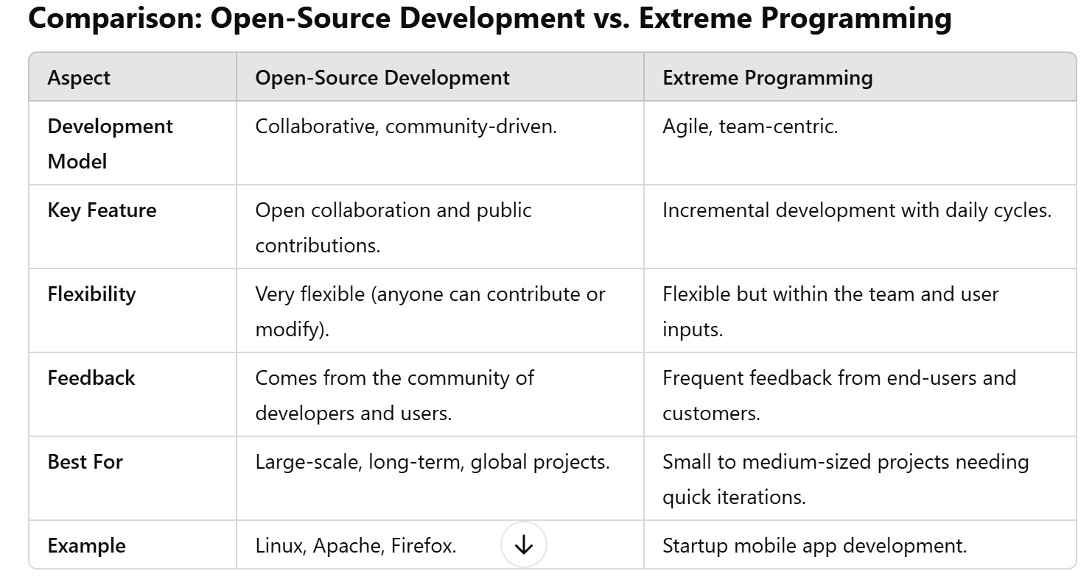
7-<number>

Slide 17
Modularity
Modularity: the division of software into manageable units called modules
Procedures -- Imperative paradigm
  Structure charts
Objects -- Object-oriented paradigm
  Collaboration diagrams
Components -- Component architecture
7-<number>

Slide 18
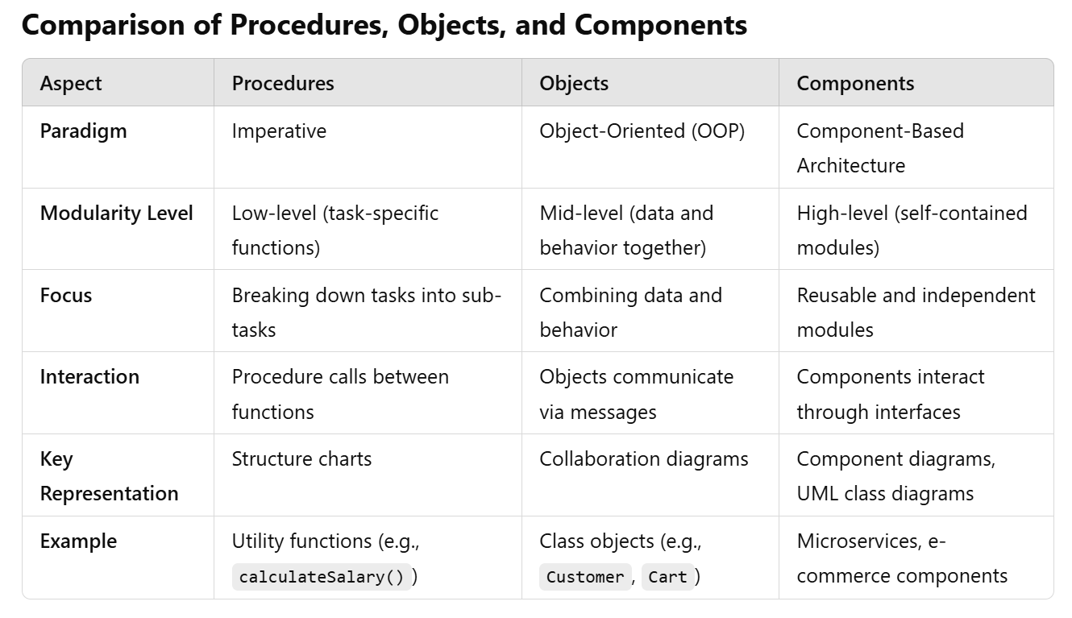
7-<number>

Slide 19
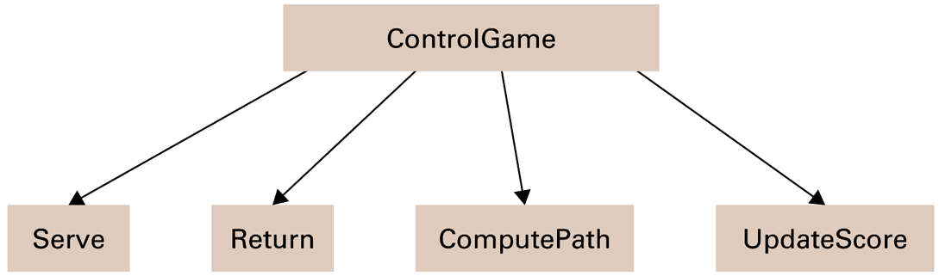
Figure 7.3 A simple structure chart
Imperative paradigm: begin by considering the actions that must take place
Structure chart: procedures and procedure dependencies
7-<number>

Slide 20
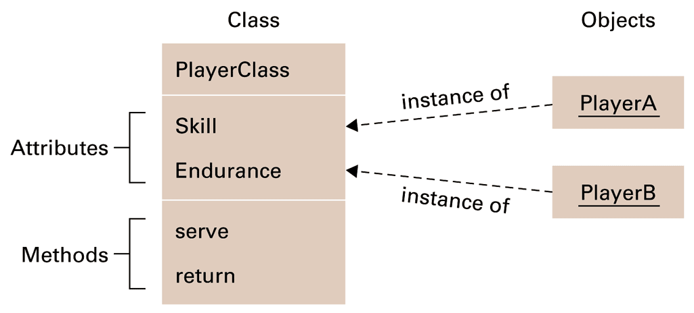
Figure 7.4 The structure of PlayerClass and its instances
There are two players that we should represent by two objects
The Judge object, the Score object
7-<number>

Slide 21
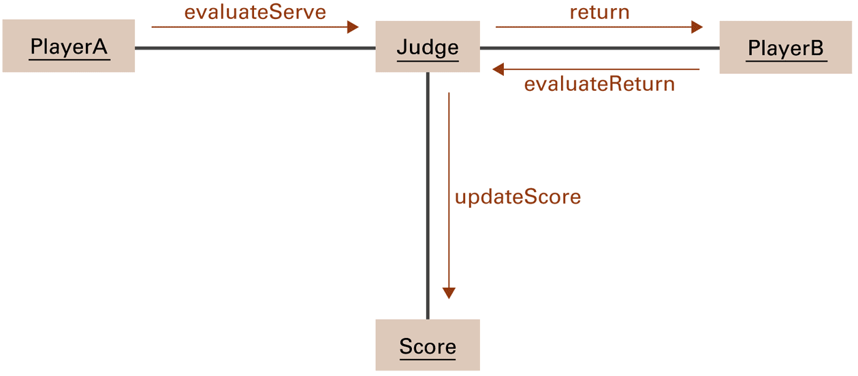
Figure 7.5 A simple collaboration diagram
7-<number>

Slide 22
Coupling
Inter-module coupling: the linkage between modules
Goal: to maximize independence among modules or minimize the linkage between modules
Control coupling: when a module passes control of execution to another
Data coupling: sharing of data between modules
  In the form of parameters
  In the form of global data
7-<number>

Slide 23
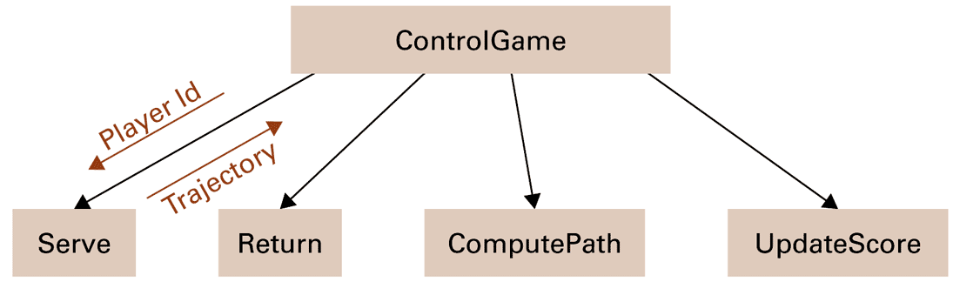
Figure 7.6 A structure chart including data coupling
7-<number>

Slide 24
Cohesion
Cohesion: the degree of relatedness of a module’s internal parts
Goal: high intramodule cohesion
Logical cohesion
  the internal elements of a module perform activities logically similar
Functional cohesion
  all the parts of the module are focused on the performance of a single activity.
7-<number>

Slide 25
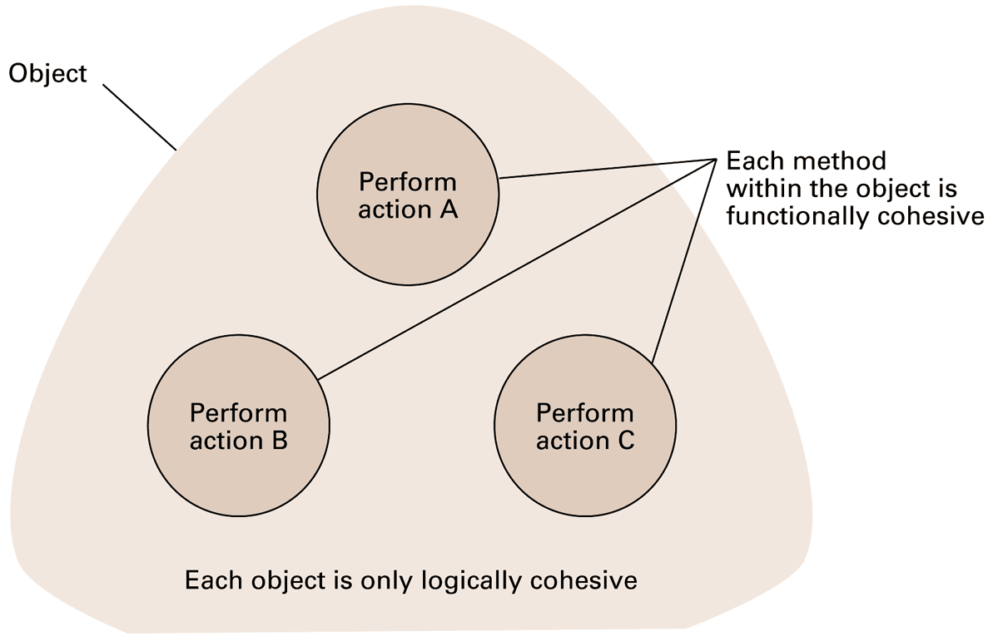
Figure 7.7 Logical and functional cohesion within an object
7-<number>

